Slide 1
SWE111 Introduction to Software Engineering Google Class Room code- bv7jn5 Lecture-2
Md. Anwar Hossen
Lecturer, SWE, DIU
anwar.swe@diu.edu.bd

Slide 2
Topics covered
Software Process model
Waterfall model
Prototyping model

Slide 3
The software process
A structured set of activities required to develop a software system.
Many different software processes but all involve:
Specification – defining what the system should do;
Design and implementation – defining the organization of the system and implementing the system;
Validation – checking that it does what the customer wants;
Evolution – changing the system in response to changing customer needs.
A software process model is an abstract representation of a process. It presents a description of a process from some particular perspective.

Slide 4
Software process models
The Waterfall Model
Prototyping Model
Agile Model
The Spiral Model

Slide 5
Software process descriptions
When we describe and discuss processes, we usually talk about the activities in these processes such as specifying a data model, designing a user interface, etc. and the ordering of these activities.
Process descriptions may also include:
Products, which are the outcomes of a process activity;
Roles, which reflect the responsibilities of the people involved in the process;
Pre- and post-conditions, which are statements that are true before and after a process activity has been enacted or a product produced.

Slide 6
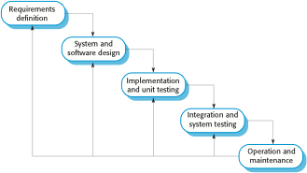
The waterfall model

Slide 7
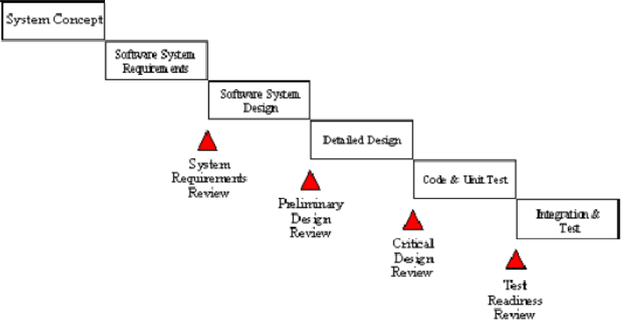
The waterfall model (cont..)

Slide 8
Waterfall model phases
There are separate identified phases in the waterfall model:
Requirements analysis and definition
System and software design
Implementation and unit testing
Integration and system testing
Operation and maintenance
The main drawback of the waterfall model is the difficulty of accommodating change after the process is underway. In principle, a phase has to be complete before moving onto the next phase.

Slide 9
Waterfall model problems
Inflexible partitioning of the project into distinct stages makes it difficult to respond to changing customer requirements.
Therefore, this model is only appropriate when the requirements are well-understood and changes will be fairly limited during the design process.
Few business systems have stable requirements.
The waterfall model is mostly used for large systems engineering projects where a system is developed at several sites.
In those circumstances, the plan-driven nature of the waterfall model helps coordinate the work.

Slide 10
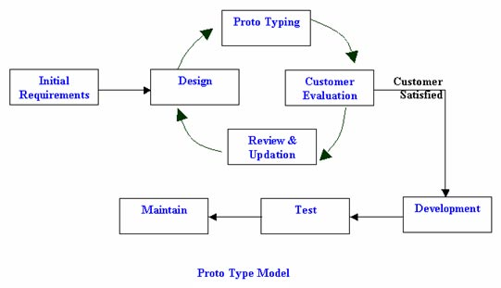
Prototyping Model

Slide 11
Prototyping Model
Software prototyping is the development approach of activities during software development
The creation of prototypes, i.e., incomplete versions of the software program being developed.
Not a standalone, complete development methodology, but rather an approach to handle selected parts of a larger
Attempts to reduce inherent project risk by breaking a project into smaller segments and providing more ease-of-change during the development process.
User is involved throughout the development process, which increases the likelihood of user acceptance of the final implementation.

Slide 12
Prototyping Model
Small-scale mock-ups of the system are developed following an iterative modification process until the prototype evolves to meet the users’ requirements.
While most prototypes are developed with the expectation that they will be discarded, it is possible in some cases to evolve from prototype to working system.
A basic understanding of the fundamental business problem is necessary to avoid solving the wrong problem

Slide 13
Advantages
You are always looking for new ways to improve the system.
This model increases the chance of having the client satisfied with the working system.
The model can be used even when the requirements are not defined.
Quicker delivery of the system

Slide 14
Disadvantages
This method can be used to avoid documenting the requirements of the system.
Management is required
Long term maintenance can be expensive
Uncertain design idea’s
Information can be lost through so many improvement changes

